Slide 1
Convolutional Neural Networks

Slide 2
Overview
Data pre-processing – 5 min
Data Augmentation – 5 min
Coding walkthrough – 30 min

Slide 3
Data pre-processing
A CNN doesn’t take pictures as input – they need tensors
Read the picture files.
Decode the JPEG content to RGB grids of pixels.
Convert these into floating-point tensors (arrays).
Rescale the pixel values (between 0 and 255) to the [0, 1] interval
Keras makes this really easy with Generators

Slide 4
Generators
Acts like an iterator
Produces one item at a time when asked
Or in batches
Memory efficient! You don’t want to load thousands of pictures into memory (you probably couldn’t if you wanted to)

Slide 5
Generator functionality
flow
flow_from_dataframe()
flow_from_directory()
We will use this one to avoid costly memory operations

Slide 6
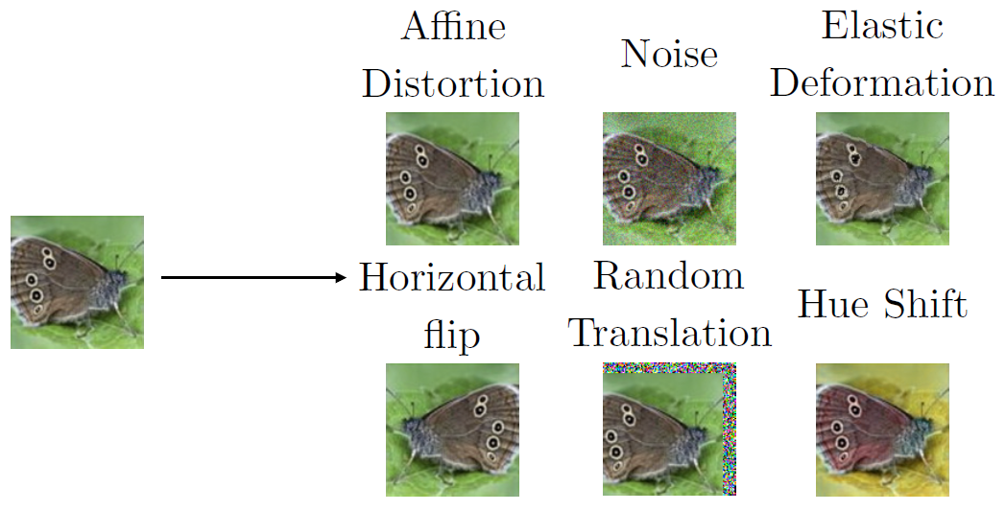
Dataset Augmentation
Domain Specific Input Transformations
Images: Crop/Rotate/Translate/Alter backgrounds/ Occlude
Sequences: Cut/Crop/Splice/Reverse
Inject (Gaussian) noise to inputs
Synthetic Data Generation

Slide 7
Code demo
DogCNN.ipynb from Canvas

